Slide 1

Web technologies using java
Course 2 – spring core

Slide 2
agenda
BASIC web application structure
What is spring framework
maven
Spring context
How to put a bean in the context
How to retrieve a bean from the context

Slide 3
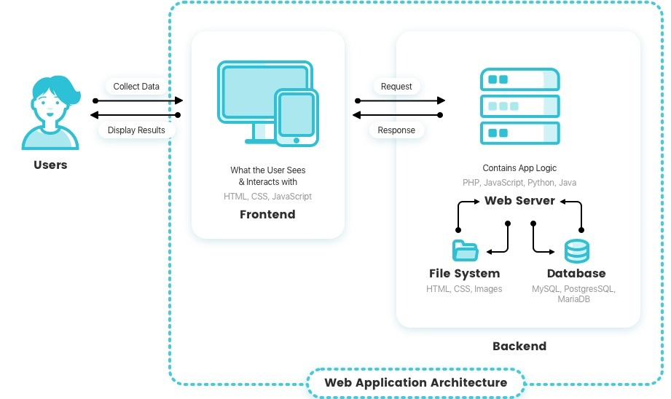
BASIC web application structure

Slide 4
What is spring framework
application framework: a set of commonly-used software functionalities that provides a foundation for developing an application.
saves time and helps ensure you have fewer chances of generating bugs.
technical code is larger than the business logic code
modular framework
real world usage:
backend apps
automation testing frameworks
desktop apps
mobile apps

Slide 5
What is spring framework
Objectives of this course using Spring:
use the Spring context and understands aspects (Spring Core)
implement data exchange between apps using REST APIs (Spring MVC)
implement the mechanism of a Spring app to connect to a database and work with the persisted data (Spring Data JDBC and Spring data JPA)
build basic apps that use the convention over configuration approach (Spring Boot)
testing Spring apps
Spring modules we will discuss further:
Spring Core
Spring MVC
Spring Boot
Spring Data JDBC
Spring Data JPA
Spring Testing

Slide 6
Spring core
Provides the fundamental mechanisms used by Spring to integrate into apps:
Spring Context
Dependency Injection (DI)
Spring Aspect Oriented Programming (AOP)

Slide 7
maven
building tool
common building tasks:
downloading the dependencies needed by your app
running tests
validating that the syntax follows some rules that you define
checking for security vulnerabilities
compiling the app
pom.xml file:
dependencies
plugins
building configurations

Slide 8
Spring context
a place in the memory of your app in which we add all the object instances that we want the framework to manage
beans: object instances we add to the Spring context
not all objects in your app need to be managed by Spring
AnnotationConfigApplicationContext class is the most used approach to obtain a reference to the context

Slide 9
How to put a bean in the context
Annotation approach versus xml approach
Annotation approach:
@Bean
stereotype annotations
@Component
@Controller
@RestController
@Service
@Repository
programmatically

Slide 10
How to put a bean in the context
Steps for using @Bean:
define a @Configuration class
create a method in this class and annotate it with @Bean. This method should return the instance you want to become a bean
make Spring use the configuration class when creating the context
Steps for using stereotypes annotations:
mark the class of the bean with a stereotype annotation (for example, @Component)
add @ComponentScan to a @Configuration class, to instruct Spring where to look for stereotype annotations
make Spring use the configuration class when creating the context

Slide 11
How to put a bean in the context
Using @Bean | Using stereotypes annotations
You have full control over the creation of the bean | You have full control only after the bean is created by Spring
You can add multiple instances of the same type | You can add only one instance of a type
You can create beans of any classes | You can create beans only of classes defined in your app
You need to define one method for each bean -> a lot of code | You only add an annotation for each bean -> less code

Slide 12
How to retrieve a bean from the context
Wiring: directly calling a @Bean annotated method from another @Bean annotated method
Autowiring: you let Spring provide a value for a parameter
by name: enables the dependency injection based on bean names
by type: enables the dependency injection based on bean types
via constructor: like by type, but applies to constructor arguments
@Autowired
on constructor – production-ready apps
on attributes – proofs-of-concept and tests
on setters – rarely used

Slide 13
How to retrieve a bean from the context
Choosing from multiple beans in the context:
by type
by name
@Primary
@Qualifier
fails with an exception

Slide 14
bibliography
Spring in Action, by Craig Walls
Youtube Spring playlist, by Laurentiu Spilca

Slide 15

Q&A

Slide 16
THANK YOU
DANIELA spilcĂ

